Slide 1
Graph Searching
(Graph Traversal)
Bibliography:
[CLRS] – chap 22.2 – Breadth First Search
[CLRS] – chap 22.3 – Depth First Search

Slide 2
Graph Searching
Given: a graph G = (V, E), directed or undirected
Goal: methodically explore every vertex (and every edge)
  Side-effect: build the subgraph resulting from the trace of this exploration
Different methods of exploration =>
  Different order of vertex discovery
  Different shape of the exploration trace subgraph (which can be a spanning tree of the graph)
Methods of exploration:
  Breadth-First Search
  Depth-First Search

Slide 3
Breadth-First Search
Explore a graph by following rules:
  Pick a source vertex to be the root
  Expand frontier of explored vertices across the breadth of the frontier

Slide 4
Breadth-First Search
Associate vertex “colors” to guide the algorithm
  White vertices have not been discovered
    All vertices start out white
  Grey vertices are discovered but not fully explored
    They may be adjacent to white vertices
  Black vertices are discovered and fully explored
    They are adjacent only to black and gray vertices
Explore vertices by scanning adjacency list of grey vertices

Slide 5
Breadth-First Search
Every vertex v will get following attributes:
  v.color: (white, grey, black) – represents its exploration status
  v.pi represents the “parent” node of v (v has ben reached as a result of exploring adjacencies of pi)
  v.d represents the distance (number of edges) from the initial vertex (the root of the BFS)

Slide 6
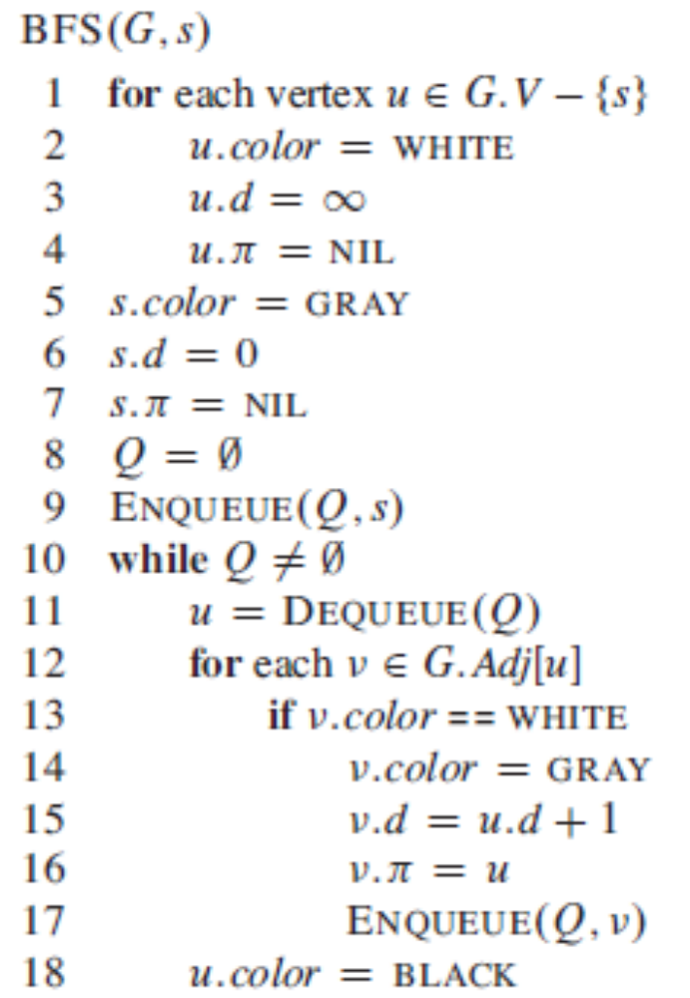
s=initial vertex (root)
Mark all vertexes except the
root as WHITE (not yet discovered)
Mark root as GREY (start exploration)
Use a Queue to store the exploration frontier
Push s in Queue
While there are nodes in the frontier (Queue)
Pop a node u from Queue
Discover all nodes v adjacent to u
Mark u as fully explored

Slide 7
Example – Applying BFS
r
s
t
u
v
w
x
y

Slide 8
Example
r
s
t
u
∞
0
∞
∞
∞
∞
∞
∞
v
w
x
y
Q
s

Slide 9
Example
r
s
t
u
1
0
∞
∞
∞
1
∞
∞
v
w
x
y
Q
w
r

Slide 10
Example
r
s
t
u
1
0
2
∞
∞
1
2
∞
v
w
x
y
Q
r
t
x

Slide 11
Example
r
s
t
u
1
0
2
∞
2
1
2
∞
v
w
x
y
Q
t
x
v

Slide 12
Example
r
s
t
u
1
0
2
3
2
1
2
∞
v
w
x
y
Q
x
v
u

Slide 13
Example
r
s
t
u
1
0
2
3
2
1
22
3
v
w
x
y
Q
v
u
y

Slide 14
Example
r
s
t
u
1
0
2
3
2
1
22
3
v
w
x
y
Q
u
y

Slide 15
Example
r
s
t
u
1
0
2
3
2
1
22
3
v
w
x
y
Q
y

Slide 16
Example
r
s
t
u
1
0
2
3
2
1
22
3
v
w
x
y
Q

Slide 17
Analysis
Θ(V)
Θ(E)
Θ(V+E)

Slide 18
Analysis of BFS
If the graph is implemented using adjacency structures:
  The adjacency list of each vertex is scanned only when the vertex is dequeued => every vertex is dequeued only once => the sum of the lengths of all adjacency lists is Θ(E)
  The total time for BFS is O(V+E)
What if the graph is implemented using adjacency matrix ?

Slide 19
Shortest paths
In an unweighted graph, the shortest-path distance δ(s,v) from s to v is the minimum number of edges in any path from s to v. If there is no path from s to v, then δ(s,v)=∞

Slide 20
Properties of BFS
If G is a connected graph, then after BFS all its vertices will be BLACK.
For every vertex v, v.d is equal with the shortest path from s to v δ(s,v)
Proofs !

Slide 21
BFS trees
The procedure BFS builds a predecessor subgraph G_{π} as it searches the graph G
The predecessor subgraph G_{π} is a breadth-first tree if V_{π} consists of the vertices reachable from s and, for all v in V_{π}, the subgraph G_{π} contains a unique simple path from s to v that is also a shortest path from s to v in G.
  A breadth-first tree is indeed a tree, since it is connected and the number of its edges is with 1 smaller than the number of vertices.

Slide 22
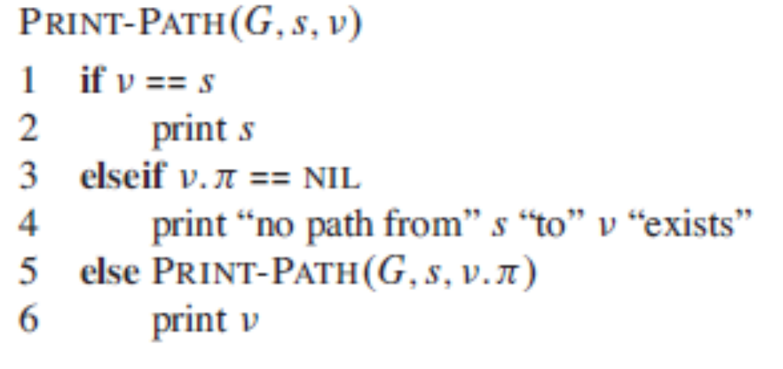
Print shortest path from s to v
Assuming that BFS has already computed a breadth-first tree with the root s:

Slide 23
BFS Questions
What happens with BFS if G is not connected ?
Is it necessary to color nodes in BFS using 3 different colors ?

Slide 24
Depth-First Search
Depth-first search is another strategy for exploring a graph
  Explore “deeper” in the graph whenever possible
  Edges are explored out of the most recently discovered vertex v that still has unexplored edges
  When all of v’s edges have been explored, backtrack to the vertex from which v was discovered

Slide 25
Depth-First Search
Vertices initially colored white
Then colored gray when discovered
Then black when their exploration is finished

Slide 26
Depth-First Search
Every vertex v will get following attributes:
  v.color: (white, grey, black) – represents its exploration status
  v.pi represents the “parent” node of v (v has ben reached as a result of exploring adjacencies of pi)
  v.d represents the time when the node is discovered
  v.f represents the time when the exploration is finished

Slide 27
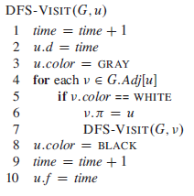
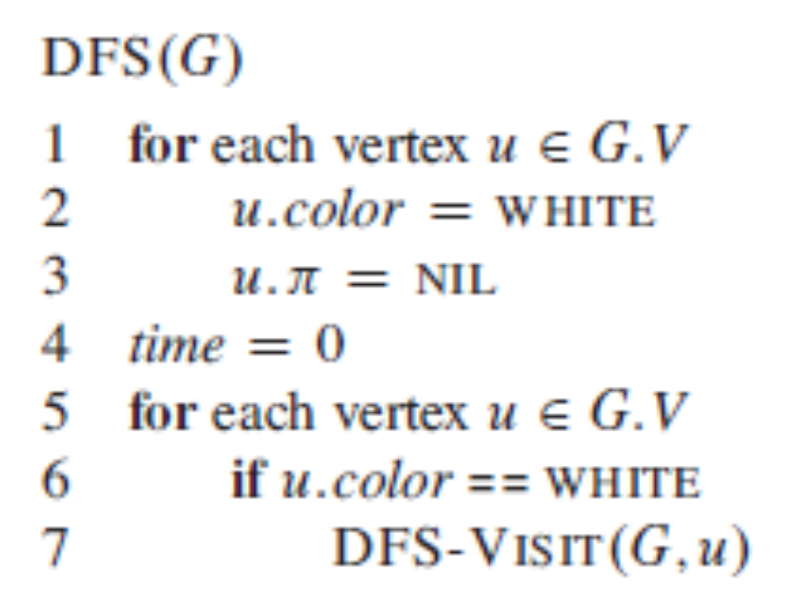

Slide 28
Example – Applying DFS
u
v
w
x
y
z

Slide 29
Example – Applying DFS
u
v
w
1/
x
y
z

Slide 30
Example – Applying DFS
u
v
w
1/
2/
x
y
z

Slide 31
Example – Applying DFS
u
v
w
1/
2/
3/
x
y
z

Slide 32
Example – Applying DFS
u
v
w
1/
2/
4/
3/
x
y
z

Slide 33
Example – Applying DFS
u
v
w
1/
2/
4/5
3/
x
y
z

Slide 34
Example – Applying DFS
u
v
w
1/
2/
4/5
3/6
x
y
z

Slide 35
Example – Applying DFS
u
v
w
1/
2/7
4/5
3/6
x
y
z

Slide 36
Example – Applying DFS
u
v
w
1/8
2/7
4/5
3/6
x
y
z

Slide 37
Example – Applying DFS
u
v
w
1/8
2/7
9/
4/5
3/6
x
y
z

Slide 38
Example – Applying DFS
u
v
w
1/8
2/7
9/
4/5
3/6
10/
x
y
z

Slide 39
Example – Applying DFS
u
v
w
1/8
2/7
9/
4/5
3/6
10/11
x
y
z

Slide 40
Example – Applying DFS
u
v
w
1/8
2/7
9/12
4/5
3/6
10/11
x
y
z

Slide 41
Properties of DFS
If G is a connected graph, then after DFS-VISIT all its vertices will be BLACK.

Slide 42
DFS Parenthesis theorem
For all vertices u and v, exactly one of the following holds:
  u.d < u.f < v.d < v.f or v.d < v.f < u.d < u.f (i.e., the intervals [u.d; u.f] and [v.d; v.f] are disjoint) and neither of u and v is a descendant of the other.
  u.d < v.d < v.f < u.f and v is a descendant of u.
  v.d < u:d < u.f < v.f and u is a descendant of v.
u.d < v.d < u.f < v.f cannot happen for any vertices !

Slide 43
Example – Parenthesis property
u
v
w
1/8
2/7
9/12
4/5
3/6
10/11
x
y
z
1
2
3
4
5
6
7
8
9
10
11
12
u
w
v
z
y
x

Slide 44
Classification of edges
Tree edges are edges in the depth-first forest G. Edge (u,v) is a tree edge if v was first discovered by exploring edge (u,v)
  a tree edge leads towards a WHITE vertex v
Back edges are those edges (u,v) connecting a vertex u to an ancestor in a depth-first tree. We consider self-loops, which may occur in directed graphs, to be back edges.
  A back edge leads towards a GRAY vertex v
Forward edges are those nontree edges (u,v) connecting a vertex u to a descendant in a depth-first tree.
  A forward edge leads toward a BLACK vertex v
Cross edges are all other edges. They can go between vertices in the same depth-first tree, as long as one vertex is not an ancestor of the other, or they can go between vertices in different depth-first trees.
  A cross edge leads toward a BLACK vertex v

Slide 45
Example – Types of edges
u
v
w
1/8
2/7
9/12
F
B
C
B
4/5
3/6
10/11
x
y
z

Slide 46
Theorem
In a depth-first search of an undirected graph G, every edge of G is either a tree edge or a back edge.

Slide 47
BFS and DFS - Conclusions
Methodically explore every vertex (and every edge) of a directed or undirected graph, build predecessor spanning trees
BFS and DFS have interesting properties, that will be useful in many applications:
  Testing connectivity (connected components, articulation points, bridges, biconnected components, strongly connected components)
  Testing existence of cycles, topological sorting

Slide 48
Priority-first search
All the graph-search methods are actually the same algorithm!
  Maintain a set S of explored vertices (the black vertices)
  Grow S by exploring edges with exactly one endpoint leaving S (the frontier of S – the grey vertices).
  The difference: which vertex from the frontier gets chosen ?
    DFS. Take vertex which was discovered most recently.
    BFS. Take vertex which was discovered least recently.
    Prim. Take vertex connected by edge of minimum weight
    Dijkstra. Take vertex that is closest to the source.
  All 4 algorithms can be implemented with a PriorityQueue; only difference is the expression of the priority value !

